Slide 1
Improving Quality of Life through Healthy Relationships and Abuse Prevention
Molly Dellinger-Wray,
mdwray@vcu.edu
VCU Partnership for People with Disabilities

Slide 2
WELCOME!
Notes:
Nicole- Introduce me:
Works at Partnership for People with Disabilities, a university center for excellence in developmental disabilities
Is an endorsed Positive Behavior Support Facilitator and certified instructor in Person Centered Thinking and Stewards of Children
Special Educator who became a parent of a child with a disability – has sat on both sides of the IEP table
Was on team to develop LEAP: Leadership for Empowerment and Abuse Prevention, a training for people with intellectual disabilities
Participated in research team to evaluate LEAP and determined that participants had positive outcomes 3 months after the intervention
Molly’s professional goal is to help improve the quality of life for everyone through developing healthy relationships

Slide 3
THANK YOU!
Notes:
This is the first step in preventing abuse of people with disabilities. Our discomfort and silence helps the perpetrators of abuse carry out their violent acts.
We have taught many people with disabilities about empowerment and abuse prevention and this webinar is intended for the people who know and support them. If you’re interested in learning more about LEAP training for teens or adults, please contact us.

Slide 4
Goals for Today
Quick: Types of Abuse
Quick: The scope of the problem
Quick: Some reasons why children and adults with disabilities experience such high rates of abuse
Dynamics of abuse
Preventing Abuse
Responding to Abuse

Slide 5
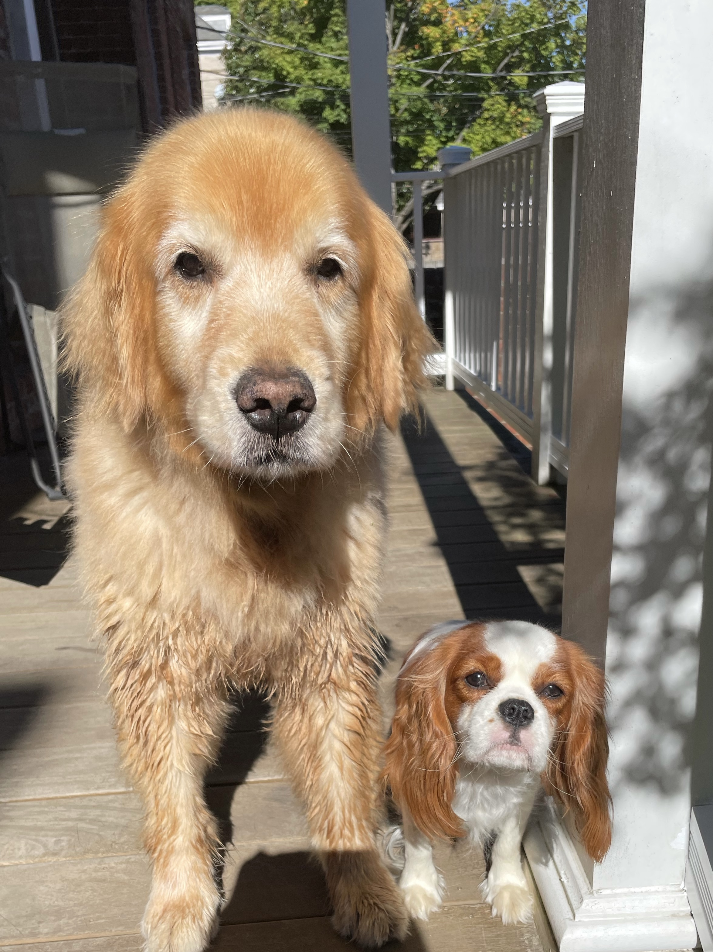
Everyone’s Perspective is different…

Slide 6
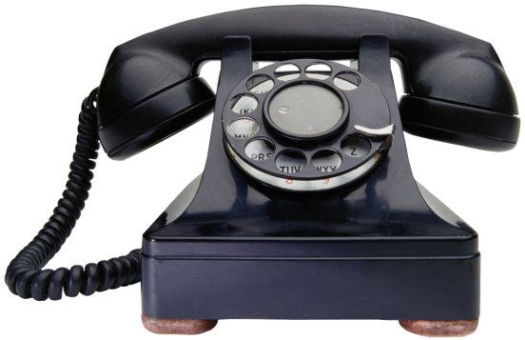
What to do if you suspect someone is being abused/neglected:
Contact your Local Department of Social Services
OR…
Virginia Family Violence
And Sexual Assault Hotline:
1-800-838-8238
Notes:
Encourage about a safety plan
Encourage them if they have spoken with a trusted adult
Ask open ended question about someone hurting them or making them uncomfortable
REPORT the problem to CPS

Slide 7
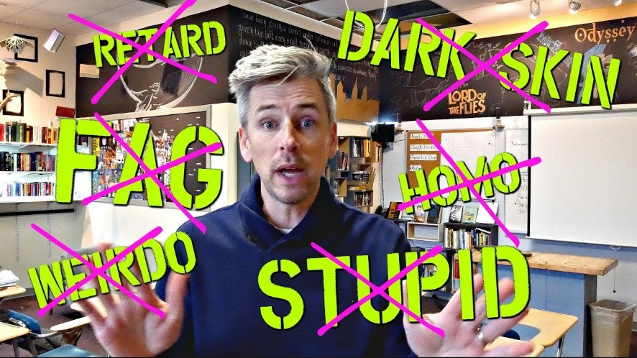
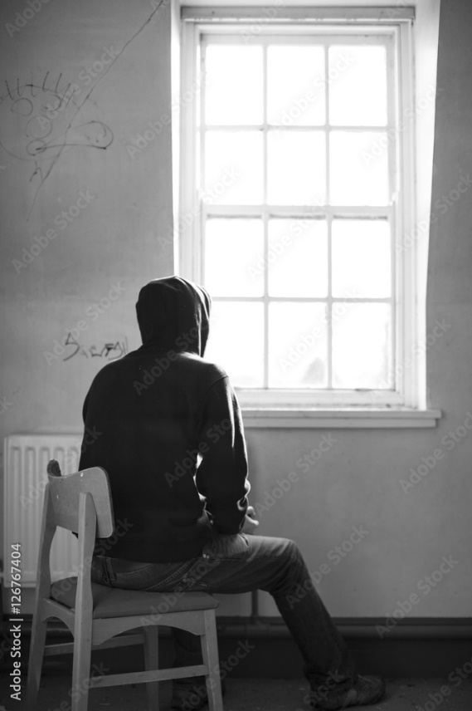
What is abuse?
Physical abuse
Emotional abuse
bullying, exclusion, institutionalization
Controlling access to family, friends, escape
Engaging in sexual acts without consent
Financial abuse (SSI)
Neglect
This does not include all of the other ways that people are marginalized by lack of choice and opportunity.
Notes:
What is abuse? There are several different types of abuse. Here are some examples:
Physical Abuse: Hitting, slapping, kicking, biting, pushing. Using, or threatening to use, a weapon. Preventing you from leaving.
Emotional Abuse: Someone calling you degrading names. Threatening to harm you or your family. Torturing your pet. Or destroying your property.
Controlling Abuse: Someone keeping you from seeing your friends or family or maybe using a vehicle.
Sexual Abuse: Forcing you to engage in sexual acts against your will.
Financial Abuse: Someone might discourage or forbid you to work, or withhold the family's financial information from you, or control all the family finances and accounts?
Neglect: Failing to provide care or medical treatment that results in injury or damages your health and safety.

Slide 8
Abuse of People with Disabilities
Typically, the person’s specific disability is used as part of the abuse
Care provider takes advantage of person’s disability to withhold necessities like personal care, food, medication, communication
Physical disabilities
Intellectual disabilities
Behavioral control
Notes:
The majority of abuse perpetrators are known by the person with IDD and can include parents, intimate partners, extended family members, teachers, transportation drivers, and paid service providers (Harrell, 2017; Stevens, 2012)

Slide 9
Abuse of People with Disabilities…
Withholding or disabling assistive devices
Hiding medications
Neglecting personal care
Refusing to transfer
Keeping the person from using accessible transportation
Disabling communication devices
Notes:
In studies we’ve done of people with disabilities who have experienced abuse or worked with abused persons with disabilities, we heard many stories of how the survivors’ disabilities were used by the perpetrators to abuse them. For example, a man who identified as blind said that his spouse would purposefully rearrange furniture and personal items in their household so that he was unable to find items when he needed them and he would bump into furniture that had been moved. Survivors told us about how their assistive devices, for example their wheelchairs, crutches, communication devices, which help them to be independent, were broken or hidden by the abusers. One woman I worked with told me of how her daughter, who was her primary caretaker, left her on the floor for the day after she had rolled off the bed attempting to get herself from her bed to her wheelchair because her daughter had refused to transfer her from the bed to her wheelchair. Another survivor told me of how her husband would refuse to get her a glass of water when her physical disability was so painful that she was unable to get up herself to get it. He also disabled her accessible van and because she lived in a rural area, she was unable to get anywhere.
Emotional abuse: - stop complaining, crying—you have nothing to be sad about.
Gaslighting
Minimizing
Invalidating

Slide 10
The SCOPE of the PROBLEM
Notes:
Evidence for this issue is scant. It is not easy to gather or interpret evidence. Data comes only from reported incidences.
Coercion and secrecy are hallmarks of an abusive relationship.
Abuse usually takes place in the home where the child lives, but also within a “closed system”. Closed systems have rigid and enforced boundaries: Families, church groups, sports teams, residential facilities.

Slide 11
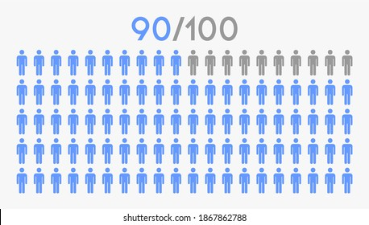
Epidemic of Abuse and Sexual Assault for people with IDD
83% 32%
49%
90% women 86% of men
83% of women and 32% of men are victims of sexual assault at some point in their lifetime. (Johnson &Sigler, 2000)
Experience abuse in their lifetime
49% of people who are victims of sexual violence will experience 10 or more incidents (Valenti-Heim & Schwartz, 1995)
Notes:
Sexually assaulted at a rate 7 times higher than the typically developing population.
(US Dept. of Justice data by NPR, 2017)

Slide 12
Bureau of Justice Statistics (2021)
A higher percentage of violence against people with disabilities was committed by persons the victim knew well or who were casual acquaintances than for victims without disabilities.
People with cognitive disabilities had highest victimization rate among the disability types measured for total violent crime.
Notes:
These are only reported crimes.

Slide 13
For people with disabilities, abuse occurs:
Children with disabilities are at least three times more likely to be abused or neglected than their peers without disabilities (Jones et al., 2012), and they are more likely to be seriously injured or harmed by maltreatment (Sedlak et al., 2010).
Four times as likely to be victims of crime
(Van Cleve & Davis, 2006)
Children with behavioral health conditions who were maltreated before age 3 were 10 times more likely to be maltreated again (Jaudes& Mackey-Bilaver, 2008)
Notes:
They experience all forms of abuse and neglect more often than other children
They are more likely to experience multiple incidents of abuse from multiple perpetrators over a longer period of time
They may have disabilities BECAUSE of the abuse and neglect
They are not fully protected by the systems that were created to protect children from abuse/neglect
Children with ID, communication disorders, behavioral disorders, and multiple disabilities have the highest risk of abuse & neglect (Sullivan & Knutsen, 2000)

Slide 14
Are
PEOPLE WITH DISABILITITES ABUSED
at such
EPEDEMIC RATES?
Notes:
It’s a fact. PEOPLE with disabilities are at increased risk for all forms of abuse and neglect, and in all types of settings.
Physical Disabilities: People with visible disabilities are often easy targets for predators who are looking for victims who do not have the ability to physically fight back.
Many people with disabilities are targets for such perpetrators because they may be perceived as being unable to physically defend themselves, or to identify the attacker or to call for help.
Perpetrators of abuse are often motivated by a desire to obtain control over others. These abusers look for victims who are vulnerable. Many perpetrators will specifically seek employment opportunities that will give them access to this population. (VERA issue brief 2013)
In 1994, Dick Sobsey noted that nearly half of all perpetrators of sexual abuse against people with developmental disabilities gained access to ether victims through disability services.
As someone who went to school to learn how to best support children with disabilities, I never like to think that people who are abusive are smart! They seek out positions where they will be around people who they view as being a potential victim. I would say that MOST people who choose to support people with disabilities as a career are NOT abusive. But SOME are, and that’s why we need to speak about this!
Expert - In 1994, Dick Sobsey noted that nearly half of all perpetrators of sexual abuse against people with developmental disabilities gained access to ether victims through disability services.

Slide 15
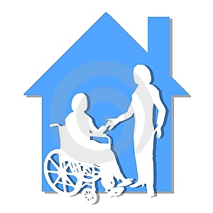
Skewed Boundaries
Notes:
High number of care providers and skewed boundaries
The need for assistance with activities of daily living, like helping someone get dressed or take a bath) increases the opportunity for abusive or intrusive touch that may cross a boundary.
People are not taught to protect themselves.
This leads to a lack of assertiveness, and personal boundaries- many people are touch tolerant.
They lack access to information about personal safety and sexual abuse prevention
Trained compliance

Slide 16
Isolation

Slide 17
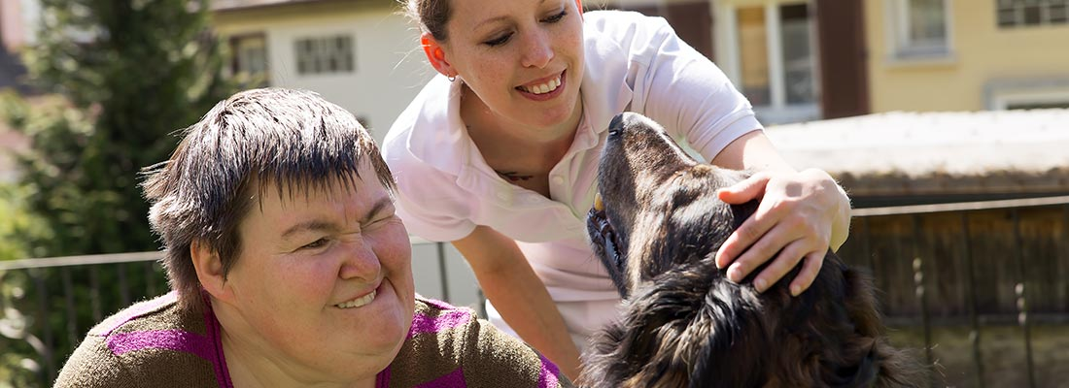
Notes:
Molly - Perpetrators gain access through disability services (Sobsey 1994)
Social skill deficits = lonliness (Fisher, Moskowitz & Hodapp, 2012)
Trained compliance (Tharinger, Horton, & Millea, 1990)
Higher number of care providers- talk about Davis vs. Patrick in number of care providers.
Skewed sense of boundaries- having been touched in private situations (bathing, going to the bathroom) makes it hard to determine illegal touch from helpful touch
Molly
Children with ID, communication disorders, behavioral disorders, and multiple disabilities have the highest risk of abuse & neglect
(Sullifan & Knutsen, 2000) Observe, Understand & Respond: the O.U.R. Children's Safety Project
http://www.handsandvoices.org/resources/OUR/index.htm

Slide 18
Notes:
Molly -
Another reason is that a child with a disability may not tell anyone about the abuse.
Sometimes, the child isn’t aware that what has happened is abusive or against the law. Adults may ask a child if someone “hurt” them. But even though being touched in a sexual way, or threatened by something is inappropriate, kids can be very literal. It wouldn’t actually HURT like getting a shot would, or getting hit.
For kids who don’t use words to communicate, or have sensory difficulties, it might be very difficult to disclose abuse or identify a perpetrator.
They frequently dismissed or not believed. They are often considered incompetent to know what is happening to them, even more so than other children, or their stories are considered fantasy.
They are sometimes viewed as “less valuable” by our society- some may think that it doesn’t matter of a child with a disability is injured or hurt, or that they can’t feel the same things as others. Societal myths and attitudes contribute to a culture in which abuse of children with disabilities more acceptable.
Beverly Franz- The “best” victim is one who can’t tell.

Slide 19
Trained compliance (Tharinger, Horton, & Millea, 1990)
“When you have a disability, people are always telling you, ‘Do as this person says! Do as this person says’ and all this other stuff.”
Thomas Mangrum – Washington, DC
Notes:
Tra

Slide 20
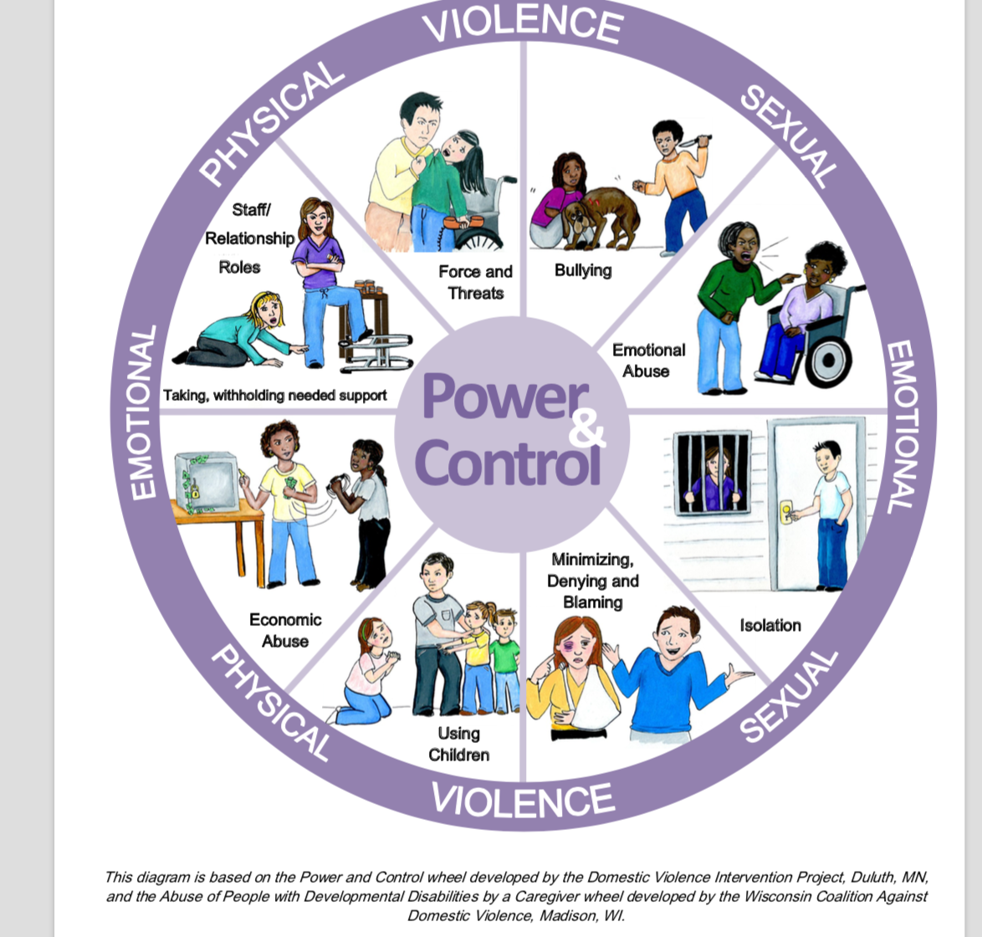
Notes:
Abuse is a pattern of behaviors used to gain or maintain power and control. The wheel serves as a diagram of tactics that an abusive partner uses to keep their victims in a relationship. The inside of the wheel is made up of subtle, continual behaviors over time, while the outer ring represents physical and sexual violence. Abusive actions like those depicted in the outer ring often reinforce the regular use of other, more subtle methods found in the inner ring.

Slide 21
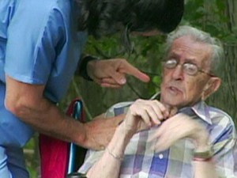
Power and Control Issues
Notes:
Paid staff members are in a natural position of leadership which can easily shift to an unhealthy dominance
Be ever vigilant of your own power struggles within your relationships with the people who you support!
Get involved when you observe in a power struggle happening between others!

Slide 22
Abusers are able to control their behavior, they do it all the time!
Abusers pick and choose who they abuse
Abusers carefully choose where and when to abuse
Abusers are able to stop their behaviors when it benefits them
Violent abusers usually target their blows in a place where they won’t show
Melinda Smith, M.A., and Jeanne Segal, Ph.D. Last updated: April 2012.
Notes:
an

Slide 23
Signs of External Authority
Access to paper, pens, computer
Jewelry, stylish appearance
Body language
Initiating greeting/touch
(B.Franz, 2014)
Notes:
Do we reward people for doing what we ask of them?
This increases their vulnerablitly.
Authority figures unintentionally help increase the risk of people with disabilities to become victims of sexual abuse and violent crime.

Slide 24
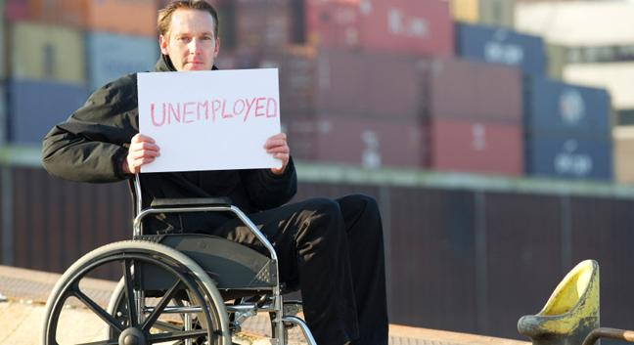
Cultural Myths and Attitudes
Notes:
Cultural Myths and attitudes
Wild promiscuous
Innocent/asexual
Incompetent, stupid
Doesn’t understand/feel
Without opinions on boundaries
Pitied / put on pedestal
Punished by God
Contagious
Behaviors;
Social distancing
Devaluation
Blaming victim

Slide 25
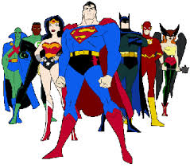
“You must be SO________”
Notes:
You must be so patient
You are a super hero. You are a saint.
What does that imply about the people who we support?

Slide 26
Abuse prevention strategies

Slide 27
Notes:
People First Language puts the person before the disability. Emphasize that the person is an individual first, and then mention the disability, ONLY if it is appropriate, which it isn’t always. People First Language describes what a person HAS, not what a person IS.
Molly:
We frequently hear kids referred to by their diagnosis only—e.g. “He’s a down’s kid” (meaning a kid with down syndrome) or “she’s a wheel chair kid”.
– talk about language that discriminates “them” from “us”. It’s the first step in preventing abuse!
- Talk about “suffering from” cerebral palsy or “being confined” to a wheelchair
George Orwell said, “If thought corrupts language, then language can also corrupts thought”.
Using artificial words—words that are not used for the general population—puts people with disabilities in a separate category from the non disabled population.
Clients
Consumers
Individuals

Slide 28
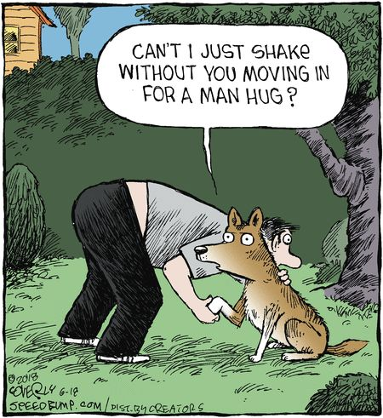
Notes:
Ask permission to touch!

Slide 29
ASK
THE HUNK
BEFORE YOU
TOUCH THE
JUNK

Slide 30
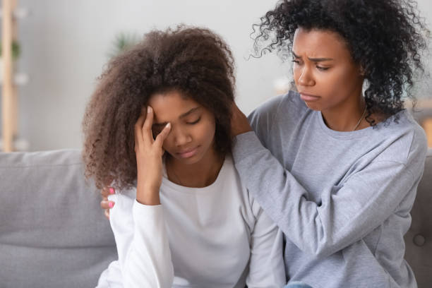
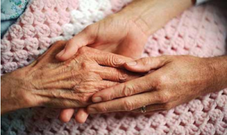

Slide 31
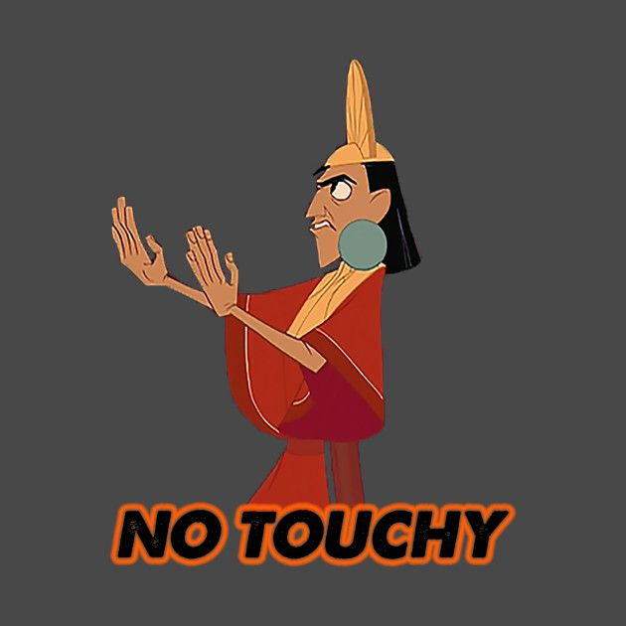
Rules for Healthy Touch
YOU decide who touches you
YOU can change your mind
Intimate touch of private body areas are okay as long as both people agree and it takes place in a private place

Slide 32
Body Parts are not dirty, secret or bad

Slide 33
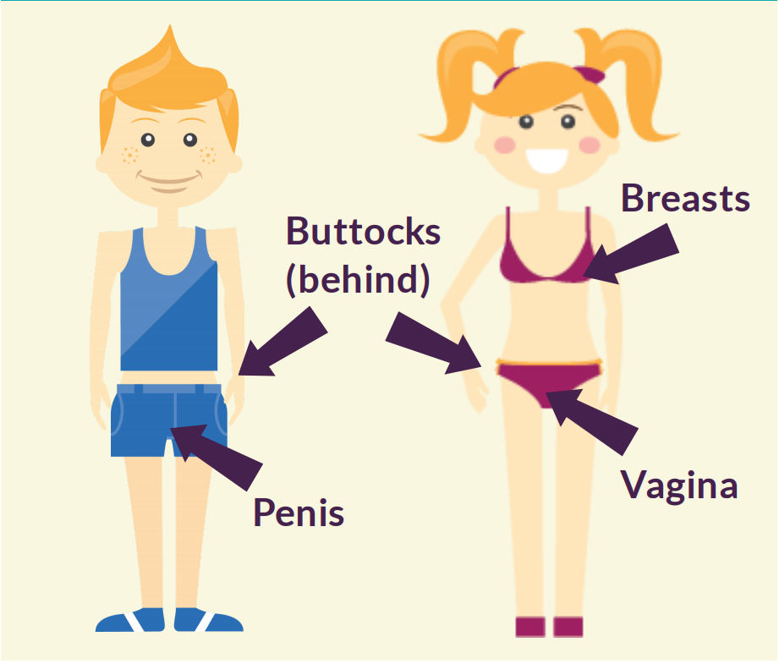
The Bathing Suit Rule
Notes:
Correct names for body parts
The bathing suit rule

Slide 34
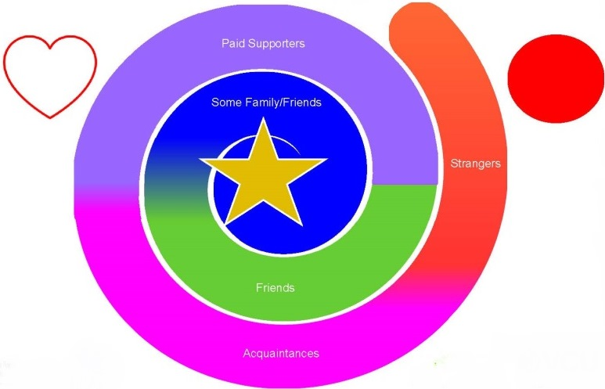
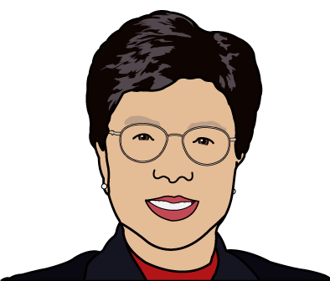
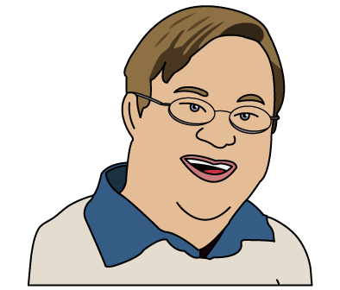
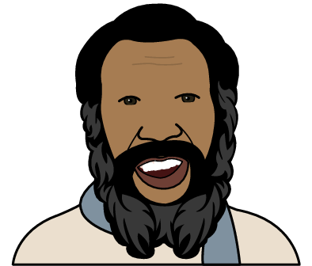
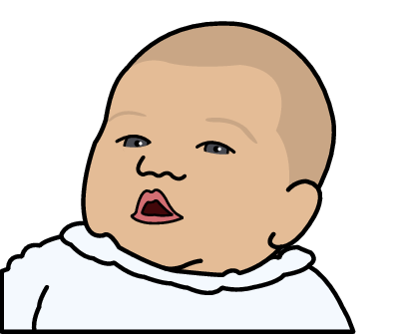
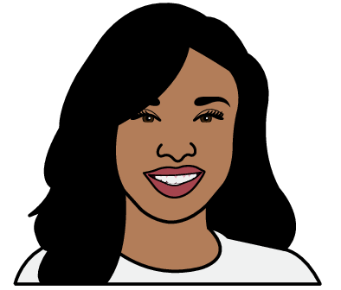
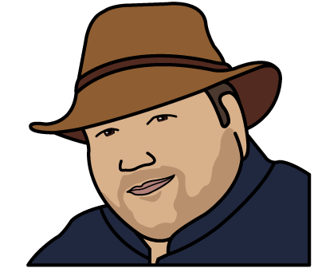
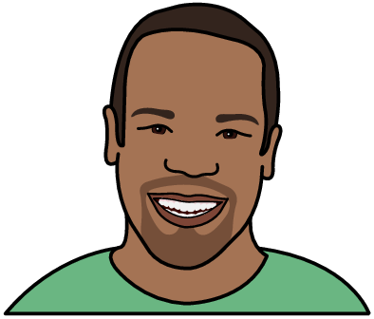
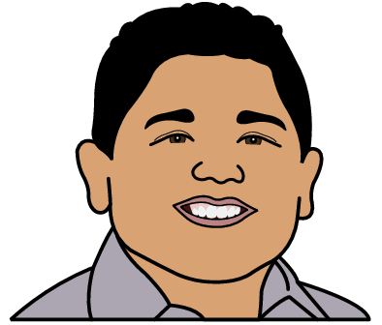
LEAP: Map of People in Your World
Paid Support
Some Family/Friends
Strangers
Friends
Acquaintance
Notes:
Use of the term “FRIEND”
If someone is nice to you are they your friend?
Setting up touch boundaries early
RED CIRCLING someone

Slide 35
Leadership for Empowerment and Abuse Prevention: LEAP
Feelings
Trust
Talk
Touch
This Photo by Unknown Author is licensed under CC BY

Slide 36
Types of Relationships
Healthy
Relationship
Confusing
Relationship
Unhealthy
Relationship
Notes:
DESCRIPTION/PURPOSE:
Introduces participants to a way to talk about relationships for the next session.
Time: 1 – 2 minutes
INSTRUCTIONS:
Review the definition of relationship from earlier in the training. A relationship is the way that two people talk and behave when they are around each other.
Read the slide aloud. Does anyone remember anything about what we talked about when we talked about relationships?
Do a refresher by asking questions like: “Can I have a relationship with my silverware? Can I have a relationship with the person who works in a restaurant that I go to every week?”
To understand relationships, it is important to understand that there are different types of relationships. Next time, we are going to talk about three types of relationships: Healthy, unhealthy, and confusing.
TIPS:
This is how we categorize relationships in LEAP. The thing about a confusing relationship is they can be unhealthy but we’re not ready to put it in the unhealthy category because it can be with someone we really trust or care for.
An example of a confusing relationship can be someone who is hot and cold, sometimes very friendly but then act like they don’t know you.

Slide 37
Paid Support or Friend?
Paid Supporters
Friends
Help you problem solve: Listen
Celebrate your successes
Provide you with necessary assistance
Advocate with you for a better quality of life
Receive Payment
Help you problem solve: Listen
Celebrate your successes
Provide you with necessary assistance
Advocate with you for a better quality of life

Slide 38
“Do you love me? Are you still my friend?”
“I am not your friend but I love working with you”
”You don’t know me well enough yet to hug me.”
“I’m not your boyfriend/girlfriend, but let’s talk about how you can find one.”
“I have so much fun with you I can’t believe I’m getting paid to do this!”
“I love everyone in the world and you are part of that world.”
Notes:
What are some other things you can say? Use the chat feature

Slide 39
How do you feel when you are around someone?
Notes:
Developing a vocabulary for those feelings and paying attention to them

Slide 40
Teaching whom to trust
How long have you known this person?
Longevity of the relationship
Has the person ever hurt you on purpose?
Evaluate past behavior
How do you feel when you are with this person?
Trust your gut! Do you ever feel nervous or scared around this person?
Can you be yourself around this person?
TRUST

Slide 41
Identifying ONE person who can be trusted
Notes:
In LEAP we ask people one person that they can put on their cards that they can trust. What we know about kids who can be resilient have at least one adult they can trust in their life.

Slide 42
What strategies were you taught to stay safe?

Slide 43
Using FEAR and PUNISHMENT to prevent abuse
DO SAY….
DON’T SAY…
Is there anything that made you uncomfortable?
What would you like to change for next time?
Some secrets were not meant to be secrets
It’s my job to keep you safe and happy and if you ever feel unsafe, please let me know
Discuss a safety plan
Don’t let anyone touch you
Don’t get in a car with anyone
Remember that ”the bathing suit rule” doesn’t apply to everything….
Notes:
Unintentionally silence the victims.
Bathing suit rule

Slide 44
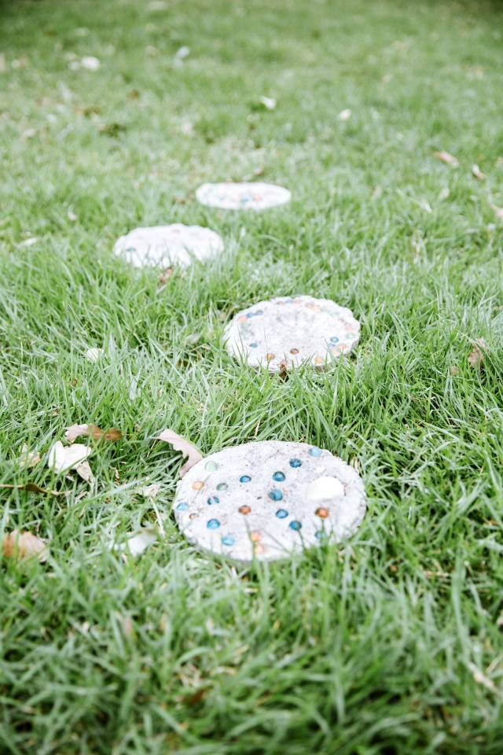
Disclosing Abuse

Slide 45
Disclosing Abuse

Slide 46
Validate without minimizing
“You seem really upset about that.”
“Tell me about why you are sad/mad/upset/angry?”
“It doesn’t seem fair: what else could you do?”
“It’s okay to be sad/mad/upset/angry”
Shenandoah Chefalo, Garbage Bag Suitcase

Slide 48
Responding: It’s time to call an expert!

Slide 49
RESPONDING
Mandated Reporters
Adult Protective Services
Forensic Interviewing

Slide 51
High Five! Any questions?

Slide 52
Quiz/Certificates
Quiz will end at the close of business today!
Enter your name EXACTLY as you would like it to appear on your certificate. NO TYPOS.
Pay attention to the question, especially the third one which asks which one is NOT an example
Read all of the choices and pick the best one
Certificates will go out by Monday, Sept. 27!

Slide 53
Quiz Review
People with disabilities experience higher rates of abuse than non disabled people. One reason for this is:
Power and Control Issues

Slide 54
Quiz Review nsues
Person centered practices are one of the best ways to prevent abuse. An example of being person centered is:
Notes:
Paid staff members are in a natural position of leadership which can easily shift to an unhealthy dominance
Be ever vigilant of your own power struggles within your relationships with the people who you support!
Get involved when you observe in a power struggle happening between others!

Slide 55
Quiz Review
When teaching someone about being safe:

Slide 56
Quiz Review
If someone discloses abuse to you:

